Slide 1
Extracting Training Data from Large Language Models
Abhishek Srikanth
Lakshmi Swaminathan
Carlini, Nicholas, et al. "Extracting training data from large language models." 30th USENIX Security Symposium (USENIX Security 21). 2021.

Slide 2
What are Large Language Models (LLMs) ?

Slide 3
Training Data Used for Large Language Models (LLMs)

Slide 4
Memorization In Large Language Models (LLMs)?

Slide 5
Formal Definition of Memorization in Large Language Models

Slide 6
Model Knowledge Extraction

Slide 7
Eidetic Memorization

Slide 8
Are Training Data Attacks Feasible with LLMs?

Slide 9
"at least one memorized training example among the 1,000 GPT-3 samples that OpenAI originally released in its official repository"

Slide 10
What is the Threat Model? Capabilities and Objectives

Slide 11

What is the Target?
OpenAI's GPT-2

Slide 12
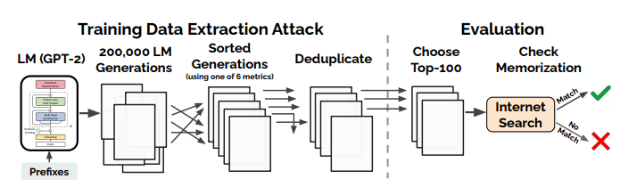
Methodology

Slide 13
Top-n Sampling Technique
Text Generation
Techniques
Decaying Temperature
Internet Data Conditioning

Slide 14
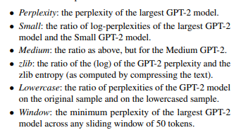
Sorting
Techniques

Slide 15
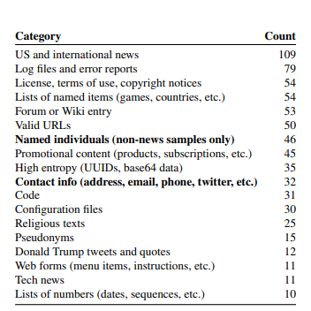

Results

Slide 16
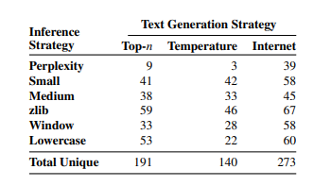
Results

Slide 17
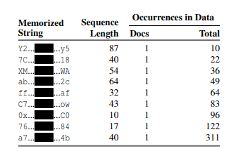
Results

Slide 18
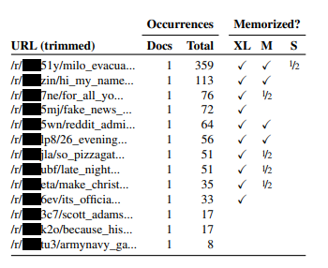
Results

Slide 19
Reimplementation

Slide 20
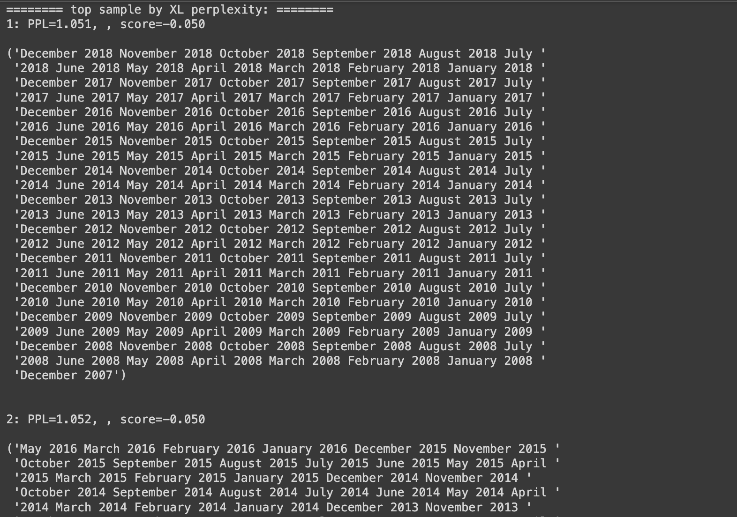

Slide 21
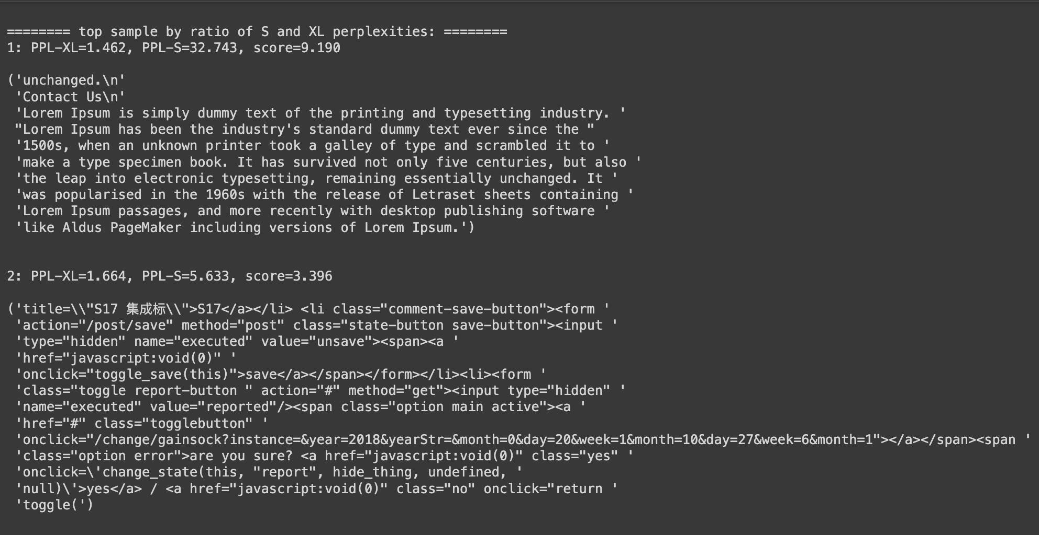

Slide 22
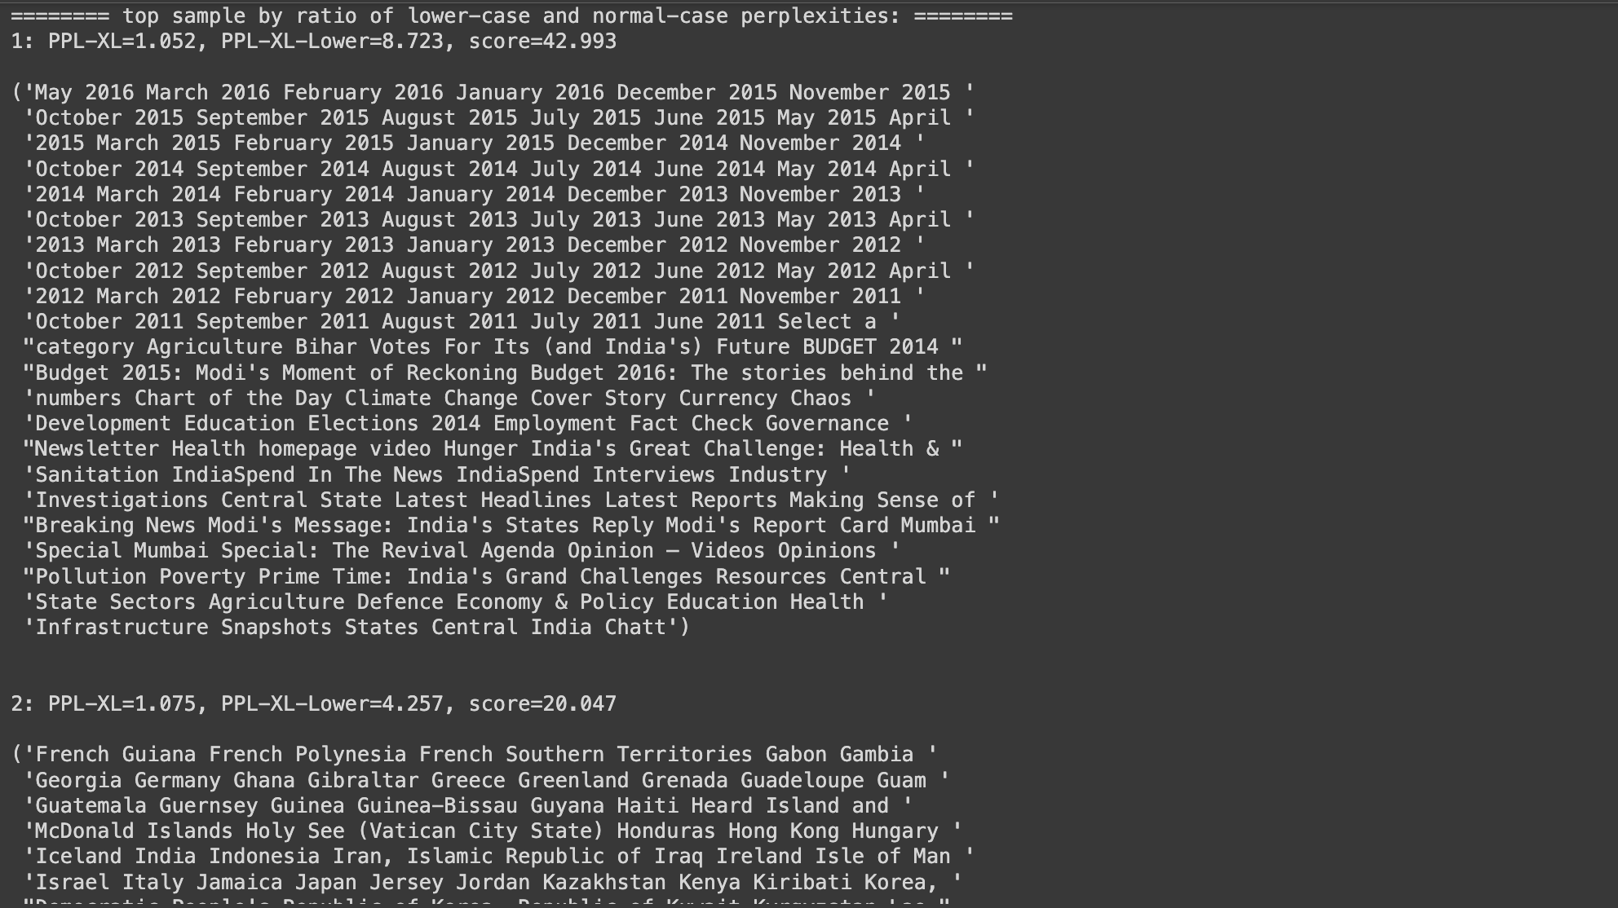

Slide 24
Our Enhancements
Google Colab Notebook

Slide 25
Mitigating Privacy Leakage in LMs

Slide 26
Mitigating Privacy Leakage in LMs
Training With Differential Privacy

Slide 27
Mitigating Privacy Leakage in LMs
Curating the Training Data

Slide 28
Mitigating Privacy Leakage in LMs
Limiting Impact of Memorization on Downstream Applications

Slide 29
Open Questions and
Future Work

